Slide 1

教学辅助课件
牛津 七年级下

Slide 2
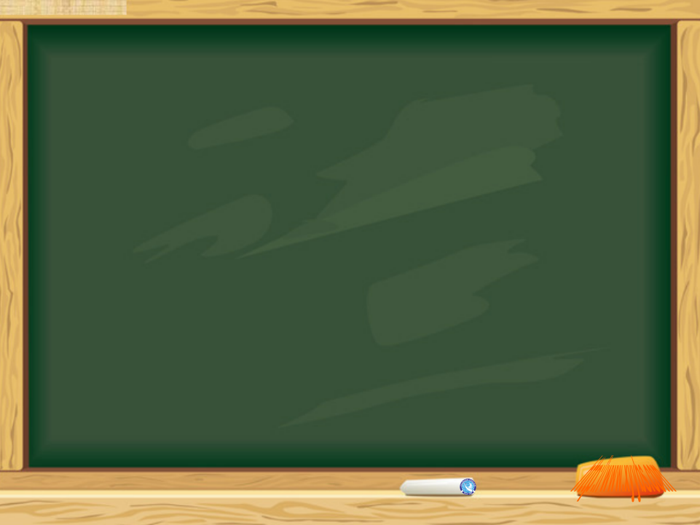
Unit 5
Grammar
Simple past tense (I)

Slide 3
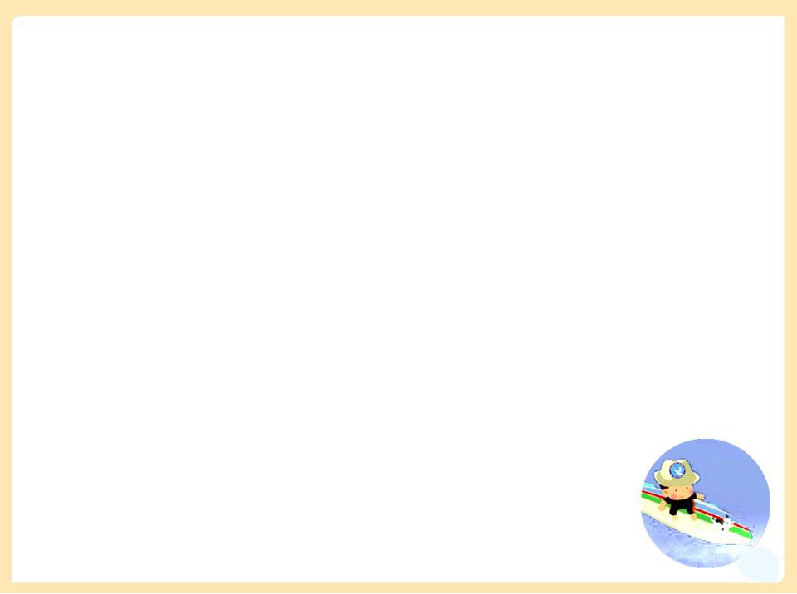


Words & phrase review
ago
the day before yesterday
centimetre
dodo
adv. 以前
前天
n. (=cm) <英>厘米，公分
<美>centimeter
n. 渡渡鸟
Read after the tape and speak out the Chinese immediately.

Slide 4
Objectives
1. To learn the past simple of verbs (regular verbs/ irregular verbs )
2. To learn to use the simple past tense
3. To learn the new words and useful expressions

Slide 5

Focus on
Words:
ago centimetre dodo
Expressions:
a month ago have a great time
take photos the day before yesterday
11 centimetres tall
Patterns:
There were a lot of people there.
We spent three hours in the museum.
What else?

Slide 6

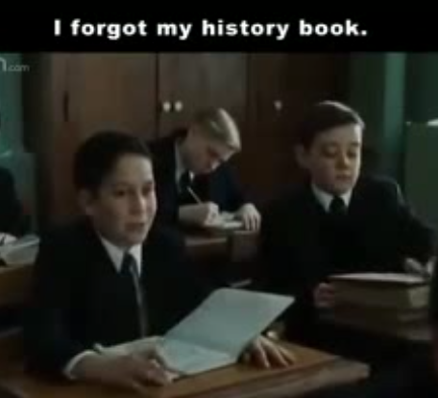

Aahaha, Charlie! Charlie bit me.
2. I learned many things from my father.
3. Max! You brought them here?
Thank you.
4. I forgot my history book.
5. Milo, you saved me.
6. I changed my mind.
7. — Mom, Dad! I made a friend today!
— Kip, really?
— You did?
— Yeah!
Watch the video and pay attention to the underlined words.
We use the simple past tense to talk about things in the past.

Slide 7
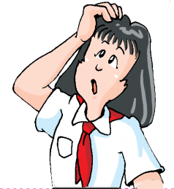
bit
went
No.
studied
made
saved
had
did
invented
was
stayed
read
cleaned
stopped
brought
Do these verbs change in the same way?
were
took
looked
bought
met
said
ate
changed
worked
forgot
played

Slide 8


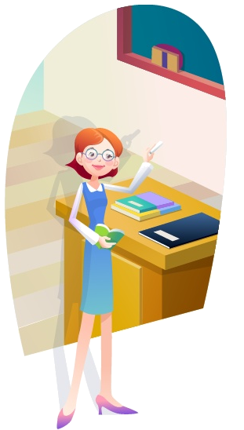
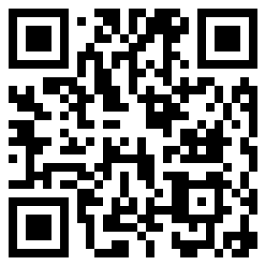
Focus on
基本含义和用法
一般过去时用于描述过去某个时间发生的动作或存在的状态。
常与表示过去的时间状语或从句连用。

Slide 9

谓语动词变形
谓语动词的变化规则
①规则变化②不规则变化
1. 表示过去某个时
间发生的动作或
存在的状态。
2. 表示过去经常或
反复发生的动作。
一般
过去时
用法
常用
时间状语
yesterday
last night
in 1990
two days ago

Slide 10
一、动词过去式的构成
规则动词过去式的构成
构成规则 | 原形 | 过去式
 | work play | worked played
 | hope live | hoped lived
 | stop plan | stopped planned
 | study worry | studied worried
一般情况在动词末尾加-ed
以e结尾的动词加-d
以重读闭音节结尾的动词，末尾只有一个辅音字母，先双写这个辅音字母，再加-ed
以辅音字母加y结尾的动词，变“y”为“i”再加-ed

Slide 11

Verbs
Past tense
am/is
are
begin
break
bring
was
were
began
broke
brought
不规则动词表
can
catch
come
can
caught
came
do
draw
drink
did
drew
drank
eat
ate

Slide 12
Verbs
Past tense
不规则动词表
fall
find
fell
found
get
go
give
got
went
gave
have
hear
hide
had
heard
hid
make
meet
made
met
see
write
saw
wrote

Slide 13
二、一般过去式的用法
表示过去某个时间发生的动作或存在的状态。
(1)He said that yesterday.
(2)Did you have a good time last summer?
2. 表示过去经常或反复发生的动作。
(1)My father often went to work by bus last year.
(2)When I was a child, I often listened to music.

Slide 14
三、常用时间状语
时间状语
He said that yesterday.
(2) Did you have a good time last summer?
(3) My father often went to work by bus last year.
常与一般过去时连用的时间状语有:
yesterday
yesterday morning (afternoon, evening …)
last night (week, month, year …)
two days ago, a week ago, three years ago …, in 1990, (in 1998 …)
…

Slide 15


k
直击中考
David is a tennis player. He ____ to play tennis when he was six years old.
(2018年北京)
begins B. will begin
C.began D. has begun
2. —Jerry, have you ever been to the Great Wall?
—Yes. I____ there with my parents last year.(2018年天津)
A. go B. went
C. will go D. have gone

Slide 16
3.They don’t live here any longer. They ___ to Chengdu last month. (2018重庆)
move B. moved
C. will move D. are moving
4. I’ve just returned (返回) from my trip to London. I____ many interesting places there. (2017江西)
visit B. will visit
C. am visiting D. visited

Slide 17
Millie wants to practise using the simple past tense. Help her write the simple past tense of the verbs below. (P 62)
A
start ______ 7. meet _____
love ____ 8. hear ______
play ______ 9. leave ______
plan _______ 10. tell ______
replay ______ 11. stand _____
say _____ 12. bring _______
started
met
loved
heard
played
left
planned
told
replied
stood
said
brought

Slide 18
B
The students visited the Fun World Museum. Here is Millie’s diary entry. Help her complete it with the simple past tense of the verbs in brackets. (P 62)
This morning, we ____ (go) to the Fun
World Museum. When we ___ (get) to the
museum, there ____ (be) a lot of people there.
We _____ (spend) three hours in the museum.
I ____ (take) a lot of photos. Some of us
______ (buy) cards of the animals there. We
_____ (come) back to school at 1 p.m. We
_____ (have) a great time!
went
got
were
spent
took
bought
came
had

Slide 19
Millie: We ____ (go) to the Fun World
Museum the day before yesterday,
Daniel. It ____ (be) so interesting!
Daniel: Really? Tell me all about it.
Millie: OK. We ___ (see) a small monkey, only 11 centimetres tall!
Daniel: That’s amazing! What else?
Millie: We also ____________ (learn) about
some strange birds like dodos. They
____ (live) on the earth a long time ago.
Daniel: That’s cool!
went
was
Daniel did not go to the Fun World Museum. Millie is telling him about the visit. Help Millie complete the conversation. (P 62)
C
saw
learnt/learned
lived

Slide 20
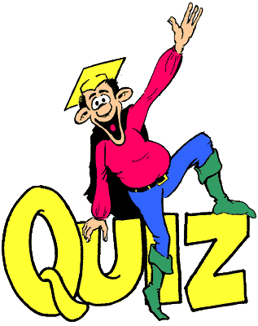


Slide 21
Ⅰ. 在横线上写出下列动词的过去式。
drink_______ drive ______
lend ________ forget______
sleep ________ begin ______
let ________ sell ________
become _______smell _______
feel _______ keep _______
think ________ cut _______
swim ________
drank
drove
lent
forgot
slept
began
let
sold
became
smelt
felt
kept
thought
cut
swam

Slide 22
Ⅱ. 用括号内单词的恰当形式填空，补全对话。
Tony: How was your weekend, Jason?
Jason: It was great. I (1)______(go) to the park and (2)_____(fly) kites with my parents.
Tony: The weather (3)____(be) fine last weekend. There must be many people in the park.
Jason: Yes. There (4)______(be) a lot of people. You know what? I (5)____(meet) Bob. He (6)______(ride) his bicycle to the park.
Tony: Did you play together?
Jason: Yes, we did. We talked and (7)______(play) cards in the afternoon. Then my parents (8)________(invite) us to a drink.
Tony: Sounds great!
Jason: How about you? Did you have a good time?
Tony: Well, I (9)_______(take) the English and Maths lessons on Saturday and
(10)________(practise) football on Sunday.
Jason: You had a really busy weekend.
went
flew
was
were
met
rode
played
invited
took
practised

Slide 23
Ⅲ. 翻译句子。
1. 我们花两个多小时参观了这个博物馆。
2. 上周末爸爸教我游泳了。
3. 马克前天买了一个铅笔盒。
4. 大约500年前，很多渡渡鸟生活在地球上。
5. 昨天傍晚露西在食堂看见了一个钥匙扣并把它捡了起来。
It took us over two hours to visit the museum.
My father taught me to swim last weekend.
Mark bought a pencil case the day before yesterday.
Many dodos lived on the earth about 500 years ago.
Lucy found a key ring and picked it up in
the dining hall yesterday evening.

Slide 24

Review the grammar we learned today.
Finish the exercises in Learning English.
3. Preview Integrated skills on pages 63-64.

